Slide 1
Biological Modeling of Neural Networks
Week 3 – part 1 : Reduction of the Hodgkin-Huxley Model
3.1 From Hodgkin-Huxley to 2D
- Overview: From 4 to 2 dimensions
- MathDetour 1: Exploiting similarities
- MathDetour 2: Separation of time scales
3.2 Phase Plane Analysis
- Role of nullclines
3.3 Analysis of a 2D Neuron Model
- constant input vs pulse input
- MathDetour 3: Stability of fixed points
3.4 TypeI and II Neuron Models
next week!
Week 3 – Reducing detail:
Two-dimensional neuron models
Wulfram Gerstner
EPFL, Lausanne, Switzerland
Notes:
The aim of a model is to understand what's going on in nature, to describe natural phenomena.
If the neuron model itself is so complicated it becomes hard to understand it, then the question arises, what can we do?

Slide 2
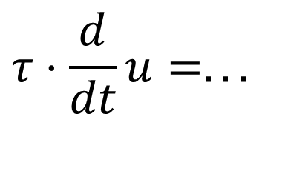
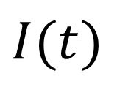
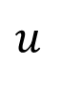
Neuronal Dynamics – 3.1. Review :Hodgkin-Huxley Model
cortical neuron
$$I(t)$$
$$u_{}$$
$$τ⋅\frac{d}{dt}u=...$$
Hodgkin-Huxley model
→Compartmental models
Na⁺

Slide 3
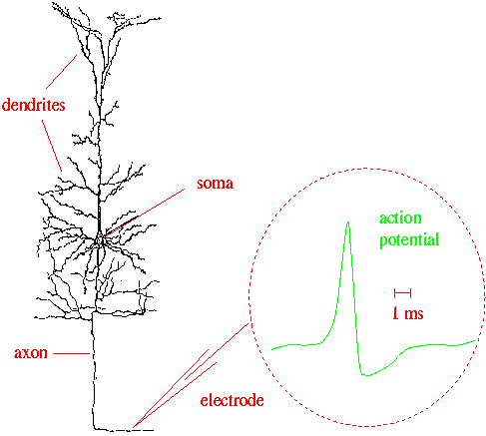
Neuronal Dynamics – 3.1 Review :Hodgkin-Huxley Model
Week 2:
Cell membrane contains
- ion channels
- ion pumps
Dendrites (week 4):
Active processes?
assumption:
passive dendrite
→ point neuron
spike generation
-70mV
Na⁺
action
potential
K⁺
Ca²⁺
Ions/proteins
Notes:
Active: 比如说pingpong-like现象
If you assume that the dendrite is passive, then indeed, the main function of the dendrite is to provide a filtering. Signals that arrive in the upper branches of the dendrite give rise to a filtered input at the soma.

Slide 4
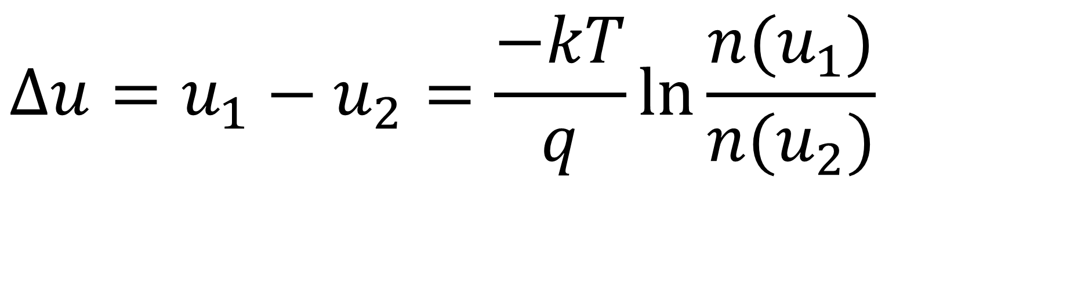
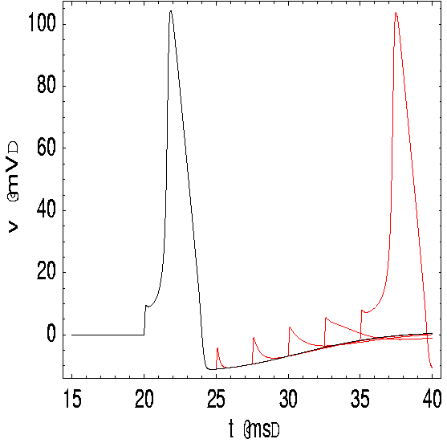
Neuronal Dynamics – 3.1. Review :Hodgkin-Huxley Model
inside
100
Ka
K
mV
Na
outside
0
Ion channels
Ion pump
$$Δu=u_{1}−u_{2}=\frac{−kT}{q}\ln{\frac{n(u_{1})}{n(u_{2})}}$$
Reversal potential
ion pumps →concentration difference ⬄ voltage difference

Slide 5
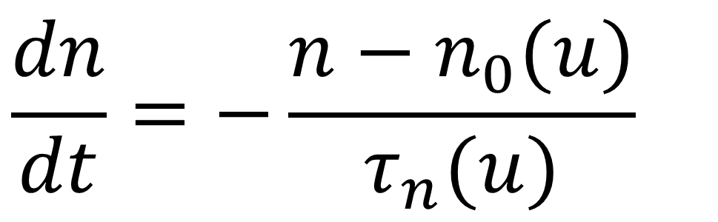
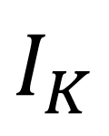
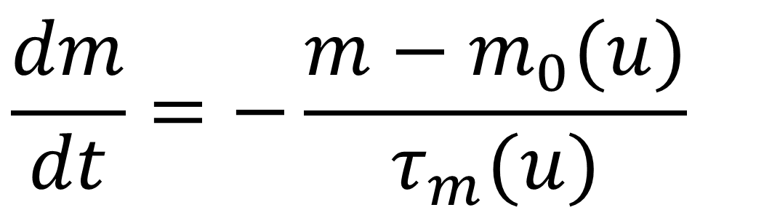
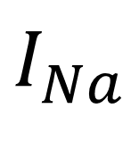
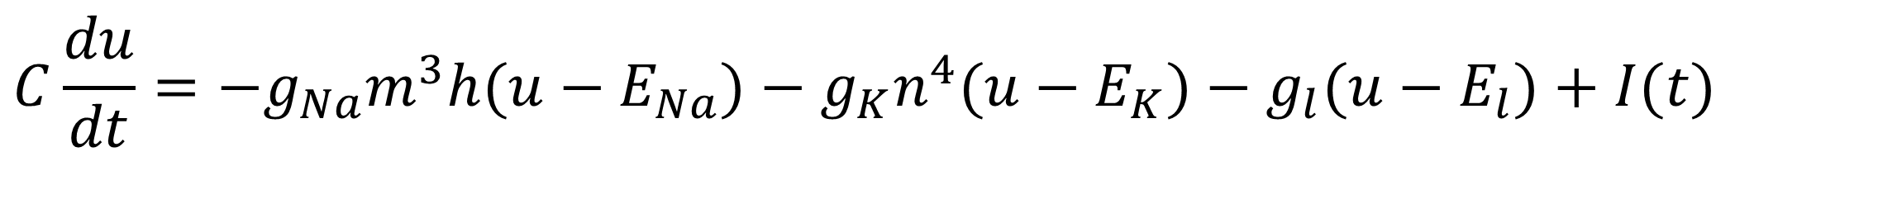
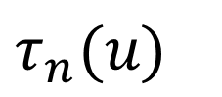

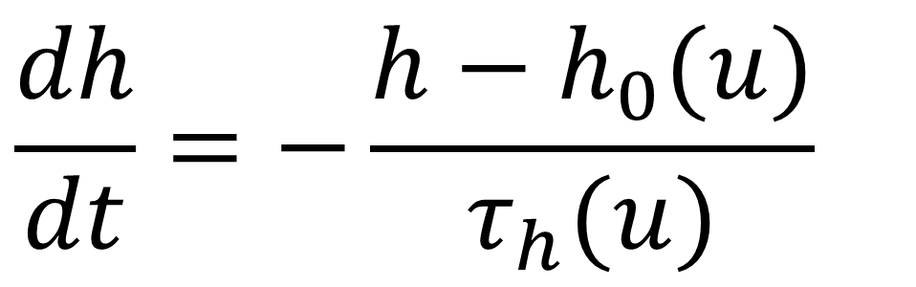
Neuronal Dynamics – 3.1. Review: Hodgkin-Huxley Model
Hodgkin and Huxley, 1952
100
inside
I
Ka
C
mV
g_{K}
g_{l}
g_{Na}
Na
0
outside
Ion channels
Ion pump
stimulus
$$I_{Na}$$
$$I_{K}$$
$$I_{leak}$$
4 equations
= 4D system
$$C\frac{du}{dt}=−g_{Na}m^{3}h(u−E_{Na})−g_{K}n^{4}(u−E_{K})−g_{l}(u−E_{l})+I(t)$$
n₀(u)
$$\frac{dh}{dt}=−\frac{h−h_{0}(u)}{τ_{h}(u)}$$
$$\frac{dm}{dt}=−\frac{m−m_{0}(u)}{τ_{m}(u)}$$
$$\frac{dn}{dt}=−\frac{n−n_{0}(u)}{τ_{n}(u)}$$
$$τ_{n}(u)$$
u
u

Slide 6
Neuronal Dynamics – 3.1. Overview and aims
Can we understand the dynamics of the HH model?
- mathematical principle of Action Potential generation?
- constant input current vs pulse input?
- Types of neuron model (type I and II)? (next week)
- threshold behavior? (next week)
→ Reduce from 4 to 2 equations
Type I and type II models
ramp input/
constant input
f-I curve
f-I curve
f
f
I0
I0
I0

Slide 7
Neuronal Dynamics – 3.1. Overview and aims
Can we understand the dynamics of the HH model?
→ Reduce from 4 to 2 equations

Slide 8
Neuronal Dynamics – Quiz 3.1.
A - A biophysical point neuron model
with 3 ion channels,
each with activation and inactivation,
has a total number of equations equal to
[ ] 3 or
[ ] 4 or
[ ] 6 or
[ ] 7 or
[ ] 8 or more

Slide 9
Neuronal Dynamics – 3.1. Overview and aims
Toward a
two-dimensional neuron model
Reduction of Hodgkin-Huxley to 2 dimension
-step 1: separation of time scales
-step 2: exploit similarities/correlations

Slide 10
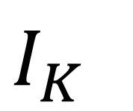
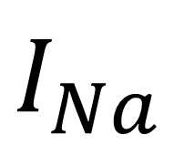
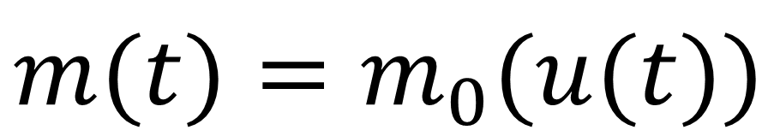
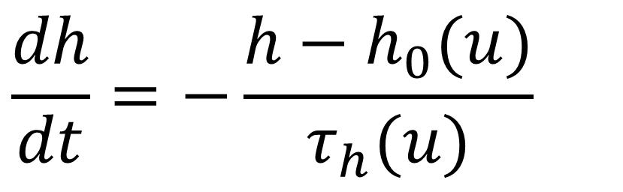
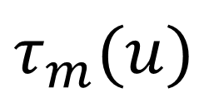
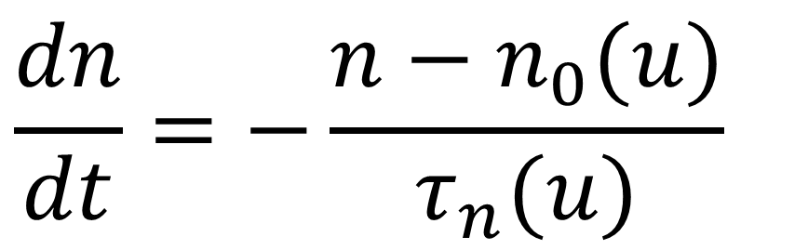
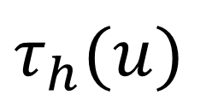
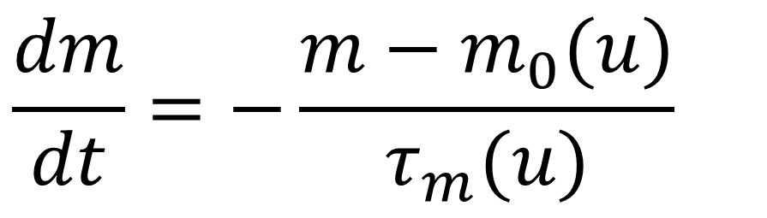
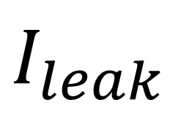
Neuronal Dynamics – 3.1. Reduction of Hodgkin-Huxley model
stimulus
$$I_{Na}$$
$$I_{K}$$
$$I_{leak}$$
$$C\frac{du}{dt}=−g_{Na}m^{3}h(u−E_{Na})−g_{K}n^{4}(u−E_{K})−g_{l}(u−E_{l})+I(t)$$
$$\frac{dm}{dt}=−\frac{m−m_{0}(u)}{τ_{m}(u)}$$
m₀(u)
$$τ_{h}(u)$$
h₀(u)
$$τ_{m}(u)$$
$$\frac{dh}{dt}=−\frac{h−h_{0}(u)}{τ_{h}(u)}$$
u
u
$$\frac{dn}{dt}=−\frac{n−n_{0}(u)}{τ_{n}(u)}$$
MathDetour
1) dynamics of m are fast
$$m(t)=m_{0}(u(t))$$
Notes:
Tau_m is fast, that means at any moment in time, we can imagine that m has already approached its value m0 for the momentary voltage u.
也就是原来电压让m在一段时间内和到m0，也就是同时和时间和电压有关。现在只和电压有关，假设m瞬间到达u对应的m
So, this is the idea of separation of time scale. One of the variables is fast, or a group of variables are fast, and these fast variables have already approached their instantaneous equilibrium value.

Slide 11
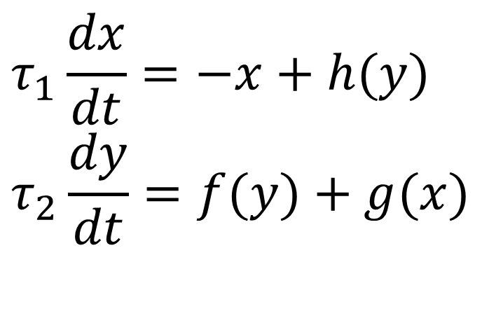
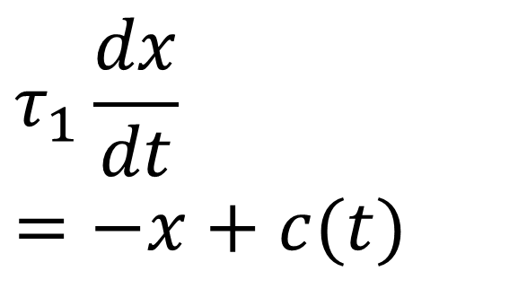
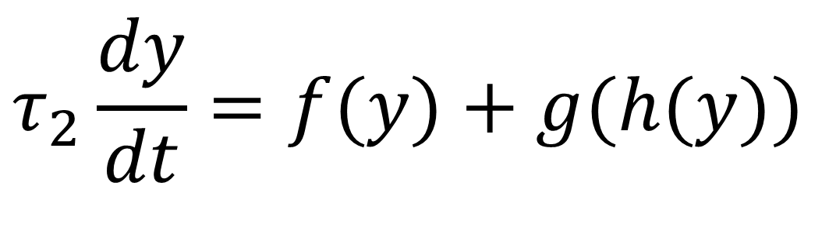
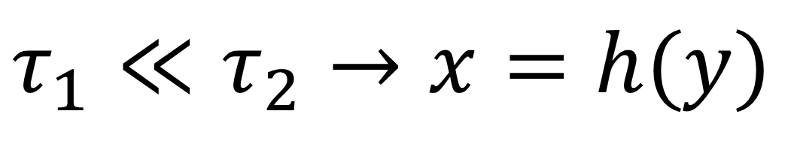
Neuronal Dynamics – MathDetour 3.1: Separation of time scales
Two coupled differential equations
$$τ_{1}\frac{dx}{dt}=−x+c(t)$$
$$τ_{1}\frac{dx}{dt}=−x+h(y) \\ τ_{2}\frac{dy}{dt}=f(y)+g(x)$$
Exercise 1 (week 3)
(later !)
Separation of time scales
$$τ_{1}≪τ_{2}→x=h(y)$$
Reduced 1-dimensional system
$$τ_{2}\frac{dy}{dt}=f(y)+g(h(y))$$
Na⁺

Slide 12
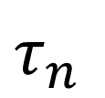
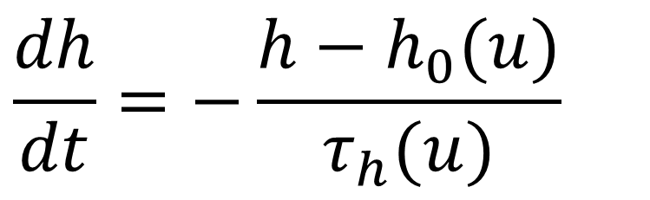
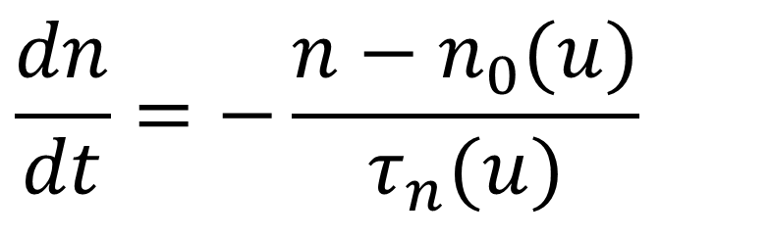
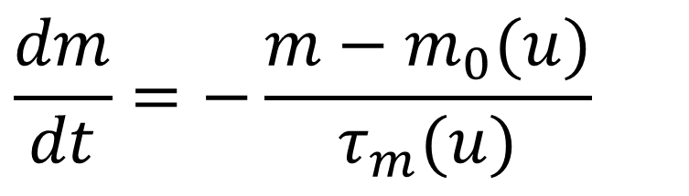
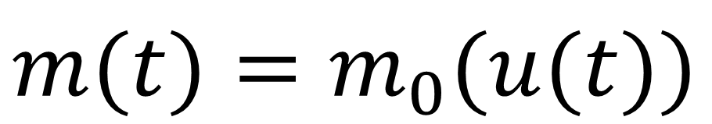
Neuronal Dynamics – 3.1. Reduction of Hodgkin-Huxley model
stimulus
$$I_{Na}$$
$$I_{K}$$
$$I_{leak}$$
$$C\frac{du}{dt}=−g_{Na}m^{3}h(u−E_{Na})−g_{K}n^{4}(u−E_{K})−g_{l}(u−E_{l})+I(t)$$
$$\frac{dm}{dt}=−\frac{m−m_{0}(u)}{τ_{m}(u)}$$
$$τ_{h}(u)$$
n₀(u)
$$τ_{n}$$
h₀(u)
$$τ_{m}(u)$$
$$\frac{dh}{dt}=−\frac{h−h_{0}(u)}{τ_{h}(u)}$$
u
u
$$\frac{dn}{dt}=−\frac{n−n_{0}(u)}{τ_{n}(u)}$$
1) dynamics of m are fast
2) dynamics of h and n are similar
$$m(t)=m_{0}(u(t))$$

Slide 13
Neuronal Dynamics – 3.1. Reduction of Hodgkin-Huxley model
Reduction of Hodgkin-Huxley
Model to 2 Dimension
-step 1:
separation of time scales
-step 2:
exploit similarities/correlations
Now !

Slide 14
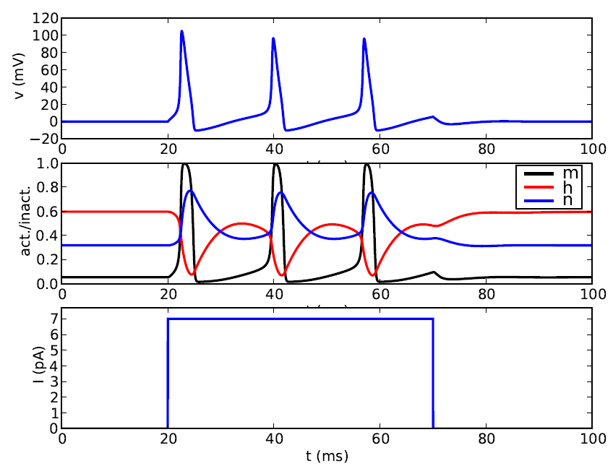
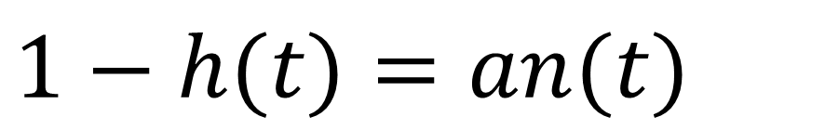
Neuronal Dynamics – 3.1. Reduction of Hodgkin-Huxley model
stimulus
$$C\frac{du}{dt}=−g_{Na}m^{3}h(u−E_{Na})−g_{K}n^{4}(u−E_{K})−g_{l}(u−E_{l})+I(t)$$
2) dynamics of h and n are similar
$$1−h(t)=an(t)$$
MathDetour
u
t
1
hrest
h(t)
nrest
n(t)
0
t
Notes:
They behave one in a mirror image of the other.

Slide 15
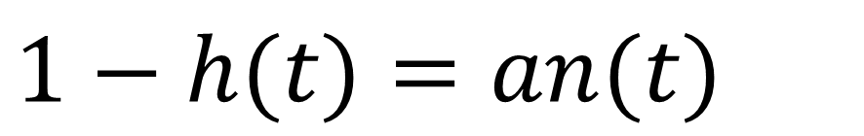
Neuronal Dynamics – Detour 3.1. Exploit similarities/correlations
dynamics of h and n are similar
h
$$1−h(t)=an(t)$$
1-h
Math. argument
n
1
hrest
h(t)
nrest
n(t)
0
t

Slide 16
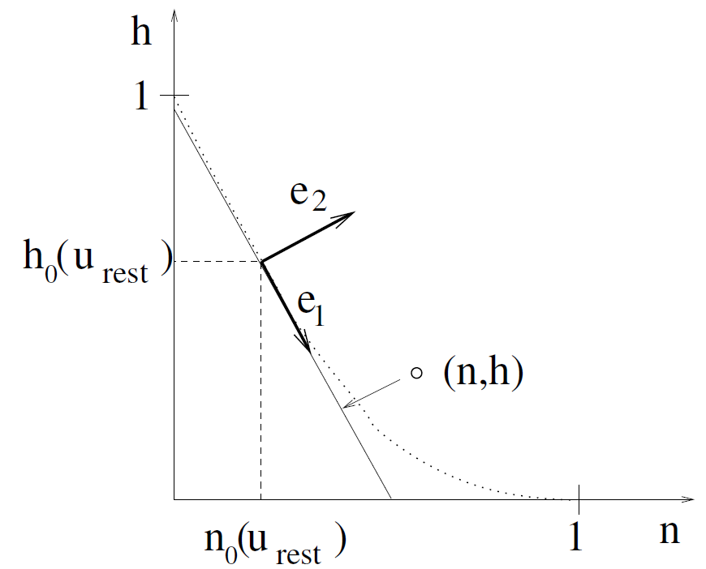
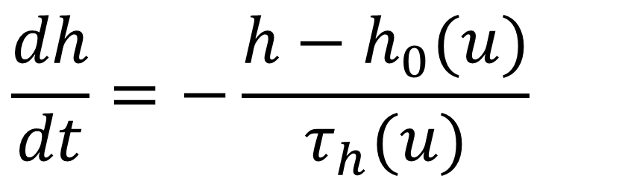
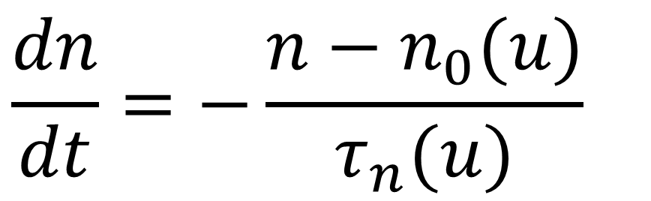
Neuronal Dynamics – Detour 3.1. Exploit similarities/correlations
dynamics of h and n are similar
$$1−h(t)=an(t)$$
at rest
n
$$\frac{dh}{dt}=−\frac{h−h_{0}(u)}{τ_{h}(u)}$$
1
hrest
h(t)
$$\frac{dn}{dt}=−\frac{n−n_{0}(u)}{τ_{n}(u)}$$
nrest
n(t)
0
t

Slide 17
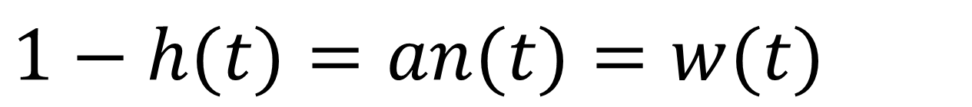
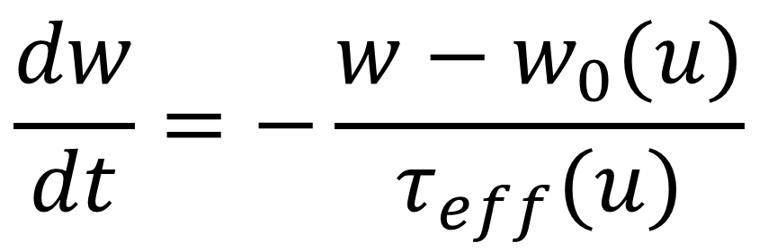
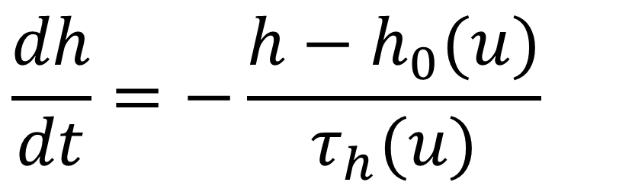
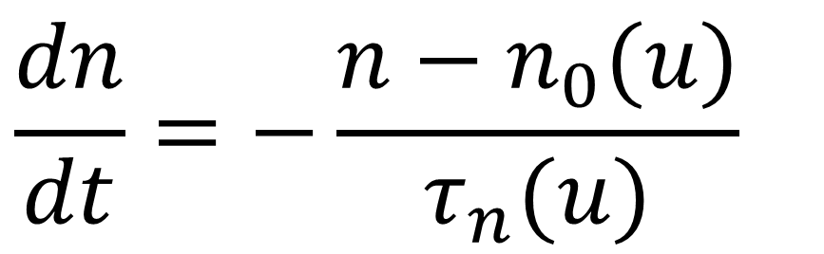
Neuronal Dynamics – Detour 3.1. Exploit similarities/correlations
dynamics of h and n are similar
Rotate coordinate system
Suppress one coordinate
Express dynamics in new variable
$$1−h(t)=an(t)=w(t)$$
n
$$\frac{dh}{dt}=−\frac{h−h_{0}(u)}{τ_{h}(u)}$$
$$\frac{dw}{dt}=−\frac{w−w_{0}(u)}{τ_{eff}(u)}$$
1
hrest
h(t)
$$\frac{dn}{dt}=−\frac{n−n_{0}(u)}{τ_{n}(u)}$$
nrest
n(t)
0
t

Slide 18
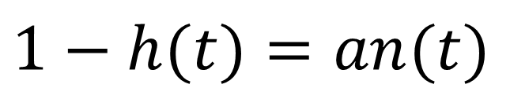
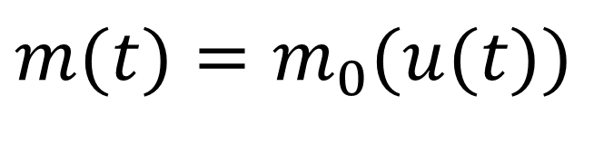
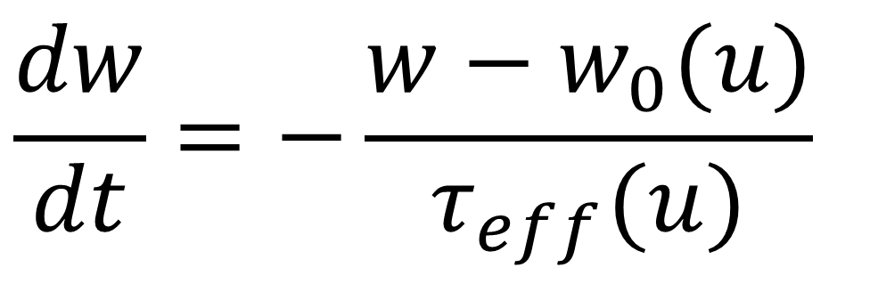
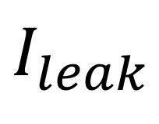
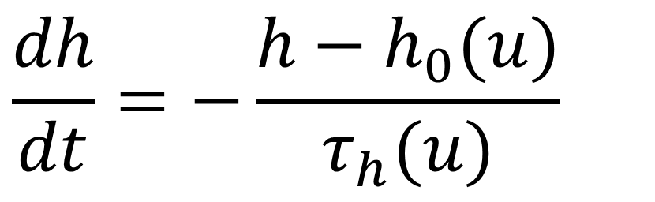
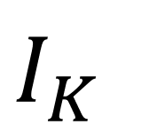
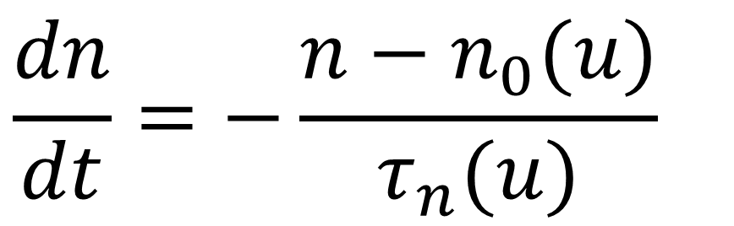
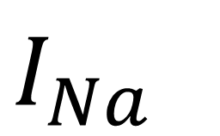
Neuronal Dynamics – 3.1. Reduction of Hodgkin-Huxley model
$$I_{Na}$$
$$I_{K}$$
$$I_{leak}$$
$$C\frac{du}{dt}=−g_{Na}[m(t)]^{3}h(t)(u(t)−E_{Na})−g_{K}[n(t)]^{4}(u(t)−E_{K})−g_{l}(u(t)−E_{l})+I(t)$$
$$C\frac{du}{dt}=−g_{Na}m_{0}(u)^{3}(1−w)(u−E_{Na})−g_{K}[\frac{w}{a}]^{4}(u−E_{K})−g_{l}(u−E_{l})+I(t)$$
1) dynamics of m are fast
$$m(t)=m_{0}(u(t))$$
2) dynamics of h and n are similar
$$1−h(t)=an(t)$$
w(t)
w(t)
$$\frac{dh}{dt}=−\frac{h−h_{0}(u)}{τ_{h}(u)}$$
$$\frac{dw}{dt}=−\frac{w−w_{0}(u)}{τ_{eff}(u)}$$
$$\frac{dn}{dt}=−\frac{n−n_{0}(u)}{τ_{n}(u)}$$

Slide 19
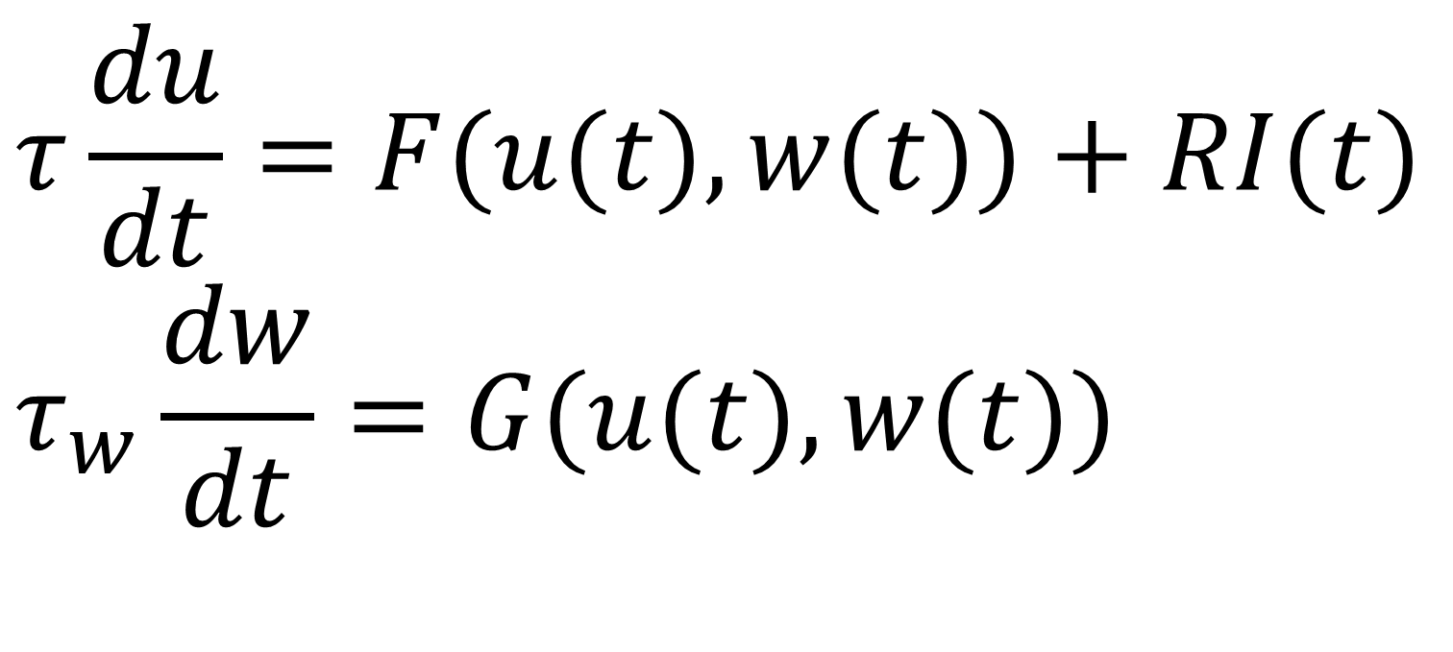




Neuronal Dynamics – 3.1. Reduction of Hodgkin-Huxley model
$$I_{Na}$$
$$I_{K}$$
$$I_{leak}$$
$$C\frac{du}{dt}=−g_{Na}m_{0}(u)^{3}(1−w)(u−E_{Na})−g_{K}(\frac{w}{a})^{4}(u−E_{K})−g_{l}(u−E_{l})+I(t)$$
$$\frac{dw}{dt}=−\frac{w−w_{0}(u)}{τ_{eff}(u)}$$
$$τ\frac{du}{dt}=F(u(t),w(t))+RI(t) \\ τ_{w}\frac{dw}{dt}=G(u(t),w(t))$$

Slide 20






NOW Exercise 1.1-1.4: separation of time scales
$$C\frac{du}{dt}=−g_{Na}m^{3}h(u−E_{Na})−g_{K}n^{4}(u−E_{K})−g_{l}(u−E_{l})+I(t)$$
$$\frac{dm}{dt}=−\frac{m−m_{0}(u)}{τ_{m}(u)}$$
$$c(t)$$
$$\frac{dx}{dt}=−\frac{x−c(t)}{τ}$$
A:
- calculate x(t)!
- what if τ is small?
0
1
t
Exercises:
1.1-1.4 now!
1.5 homework
$$x(t)$$
?
t
Exerc. 9h50-10h00
Next lecture:
10h15
$$\frac{dm}{dt}=−\frac{m−c(u)}{τ_{m}}$$
B: -calculate m(t)
if τ is small!
- reduce to 1 eq.
$$\frac{du}{dt}=f(u)−m$$

Slide 21
Biological Modeling of Neural Networks
Week 3 – part 1 : Reduction of the Hodgkin-Huxley Model
3.1 From Hodgkin-Huxley to 2D
- Overview: From 4 to 2 dimensions
- MathDetour 1: Exploiting similarities
- MathDetour 2: Separation of time scales
3.2 Phase Plane Analysis
- Role of nullclines
3.3 Analysis of a 2D Neuron Model
- constant input vs pulse input
- MathDetour 3: Stability of fixed points
3.4 TypeI and II Neuron Models
next week!
Week 3 – Reducing detail:
Two-dimensional neuron models
Wulfram Gerstner
EPFL, Lausanne, Switzerland

Slide 22




Neuronal Dynamics – MathDetour 3.1: Separation of time scales
Two coupled differential equations
Ex. 1-A
$$τ_{1}\frac{dx}{dt}=−x+c(t)$$
$$τ_{1}\frac{dx}{dt}=−x+c(t) \\ τ_{2}\frac{dy}{dt}=f(y)+g(x)$$
Exercise 1 (week 3)
Separation of time scales
$$τ_{1}≪τ_{2}$$
Reduced 1-dimensional system
$$τ_{2}\frac{dy}{dt}=f(y)+g(c(t))$$
Na⁺

Slide 23

Neuronal Dynamics – MathDetour 3.2: Separation of time scales
$$τ_{1}\frac{dx}{dt}=−x+c(t)$$
Linear differential equation
step

Slide 24

Notes:
There's a tiny, tiny little delay between the two, but it's not visible.
In fact, this becomes true in the limit that tau 1 goes to 0. Then, x will immediately take its new value, c of t.

Slide 25


Slide 26


Neuronal Dynamics – MathDetour 3.2 Separation of time scales
Two coupled differential equations
$$τ_{1}\frac{dx}{dt}=−x+c(t) \\ τ_{2}\frac{dc}{dt}=−c+f(x)+​I(t)$$
x
c
$$τ_{1}≪τ_{2}$$
‘slow drive’
I
Na⁺

Slide 27

Notes:
不光c怎么变化，因为c的变化很慢，所以x总能跟上c的变化

Slide 28
Neuronal Dynamics – Reduction of Hodgkin-Huxley model
stimulus
$$I_{Na}$$
$$I_{K}$$
$$I_{leak}$$
$$C\frac{du}{dt}=−g_{Na}m^{3}h(u−E_{Na})−g_{K}n^{4}(u−E_{K})−g_{l}(u−E_{l})+I(t)$$
$$\frac{dm}{dt}=−\frac{m−m_{0}(u)}{τ_{m}(u)}$$
$$τ_{h}(u)$$
n₀(u)
$$τ_{n}$$
h₀(u)
$$τ_{m}(u)$$
$$\frac{dh}{dt}=−\frac{h−h_{0}(u)}{τ_{h}(u)}$$
u
u
$$\frac{dn}{dt}=−\frac{n−n_{0}(u)}{τ_{n}(u)}$$
dynamics of m is fast
$$m(t)=m_{0}(u(t))$$
Fast compared to what?

Slide 29
Neuronal Dynamics – MathDetour 3.2: Separation of time scales
Two coupled differential equations
$$τ_{1}\frac{dx}{dt}=−x+h(y) \\ τ_{2}\frac{dy}{dt}=f(y)+g(x)$$
Exercise 1 (week 3)
even more general
Separation of time scales
$$τ_{1}≪τ_{2}→x=h(y)$$
Reduced 1-dimensional system
$$τ_{2}\frac{dy}{dt}=f(y)+g(h(y))$$
Na⁺
Notes:
因为tau2>>tau1，所以tau1变化的速率很快，所以x会“瞬间“到达它的平衡点h(y)

Slide 30





Neuronal Dynamics – Quiz 3.2.
A- Separation of time scales:
We start with two equations
[ ] If then the system can be reduded to
[ ] If then the system can be reduded to
[ ] None of the above is correct.
$$τ_{1}\frac{dx}{dt}=−x+y+I(t) \\ τ_{2}\frac{dy}{dt}=−y+x^{2}+A$$
Attention
I(t) can move rapidly,
therefore
choice [1]
not correct
$$τ_{1}≪τ_{2}$$
$$τ_{2}\frac{dy}{dt}=−y+[y+I(t)]^{2}+A$$
$$τ_{2}≪τ_{1}$$
$$τ_{1}\frac{dx}{dt}=−x+x^{2}+A+I(t)$$

Slide 31


Slide 32

Notes:
If I gave a different stimulus, the trajectories might be different.
However, what you find is that all data points lie in close proximity to this red dashed line.

Slide 33


Slide 34


Slide 35


Slide 36


Slide 37
Neuronal Dynamics – Quiz 3.2-similar dynamics
Exploiting similarities:
A sufficient condition to replace two gating variables r,s
by a single gating variable w is
[ ] Both r and s have the same time constant (as a function of u)
[ ] Both r and s have the same activation function
[ ] Both r and s have the same time constant (as a function of u)
AND the same activation function
[ ] Both r and s have the same time constant (as a function of u)
AND activation functions that are identical after some additive rescaling
[ ] Both r and s have the same time constant (as a function of u)
AND activation functions that are identical after some multiplicative
rescaling

Slide 38
Biological Modeling of Neural Networks
Week 3 – part 1 : Reduction of the Hodgkin-Huxley Model
3.1 From Hodgkin-Huxley to 2D
- Overview: From 4 to 2 dimensions
- MathDetour 1: Exploiting similarities
- MathDetour 2: Separation of time scales
3.2 Phase Plane Analysis
- Role of nullclines
3.3 Analysis of a 2D Neuron Model
- constant input vs pulse input
- MathDetour 3: Stability of fixed points
3.4 TypeI and II Neuron Models
next week!
Week 3 – Reducing detail:
Two-dimensional neuron models
Wulfram Gerstner
EPFL, Lausanne, Switzerland

Slide 39

Neuronal Dynamics – 3.1. Reduction to 2 dimensions
2-dimensional equation
$$C\frac{du}{dt}=f(u(t),w(t))+I(t) \\ \frac{dw}{dt}=g(u(t),w(t))$$
Enables graphical analysis!
Phase plane analysis
-Discussion of threshold
- Constant input current vs pulse input
-Type I and II
- Repetitive firing

Slide 40


Neuronal Dynamics – 3.2. Phase Plane Analysis
2-dimensional equation
stimulus
$$τ\frac{du}{dt}=F(u,w)+RI(t)$$
$$τ_{w}\frac{dw}{dt}=G(u,w)$$
Enables graphical analysis!
Application to
neuron models
Important role of
- nullclines
- flow arrows
Notes:
Once we are done in two dimensions, we can analyze the dynamics graphically.

Slide 41



Neuronal Dynamics – 3.2. Reduced Hodgkin-Huxley model
$$I_{Na}$$
$$I_{K}$$
$$I_{leak}$$
$$C\frac{du}{dt}=−g_{Na}m_{0}(u)^{3}(1−w)(u−E_{Na})−g_{K}(\frac{w}{a})^{4}(u−E_{K})−g_{l}(u−E_{l})+I(t)$$
$$\frac{dw}{dt}=−\frac{w−w_{0}(u)}{τ_{w}(u)}$$
stimulus
$$τ\frac{du}{dt}=F(u,w)+RI(t)$$
$$τ_{w}\frac{dw}{dt}=G(u,w)$$

Slide 42


Neuronal Dynamics – 3.2. Phase Plane Analysis/nullclines
2-dimensional equation
stimulus
$$τ\frac{du}{dt}=F(u,w)+RI(t)$$
$$τ_{w}\frac{dw}{dt}=G(u,w)$$
Enables graphical analysis!
u-nullcline
-Discussion of threshold
-Type I and II
w-nullcline

Slide 43





Neuronal Dynamics – 3.2. Nullclines of reduced HH model
$$\frac{dw}{dt}=0$$
stimulus
$$τ\frac{du}{dt}=F(u,w)+RI(t)$$
$$τ_{w}\frac{dw}{dt}=G(u,w)$$
$$\frac{du}{dt}=0$$
u-nullcline
w-nullcline
Stable fixed point

Slide 44


Slide 45


Neuronal Dynamics – 3.2. FitzHugh-Nagumo Model
$$τ\frac{du}{dt}=F(u,w)+RI(t) \\ =u−\frac{1}{3}u^{3}−w+RI(t)$$
MathAnalysis,
blackboard
$$τ_{w}\frac{dw}{dt}=G(u,w)=b_{0}+b_{1}u−w$$
u-nullcline
w-nullcline
Notes:
We set b0=b1-2

Slide 46


Slide 47


Neuronal Dynamics – 4.2. FitzHugh-Nagumo Model
$$τ\frac{du}{dt}=F(u,w)+RI(t) \\ =u−\frac{1}{3}u^{3}+RI(t)$$
$$τ_{w}\frac{dw}{dt}=G(u,w)=b_{0}+b_{1}u−w$$
change b1
Notes:
We set b0=b1-2

Slide 48

Notes:
From any initial condition I can construct flow patterns which will end at one of the fixed points.

Slide 49




Neuronal Dynamics – 3.2. flow arrows
$$τ\frac{du}{dt}=F(u,w)+RI(t)$$
Stimulus I=0
$$\frac{dw}{dt}=0$$
w
$$τ_{w}\frac{dw}{dt}=G(u,w)$$
Consider change in small time step
u
Flow on nullcline
I(t)=0
$$\frac{du}{dt}=0$$
Flow in regions between nullclines
Stable fixed point

Slide 50

Notes:
因为fixed point的变化值都是0，所以越靠近fixed point，变化的值就越小。

Slide 51


Slide 52
Neuronal Dynamics – Quiz 3.3
A. u-Nullclines
[ ] On the u-nullcline, arrows are always vertical
[ ] On the u-nullcline, arrows point always vertically upward
[ ] On the u-nullcline, arrows are always horizontal
[ ] On the u-nullcline, arrows point always to the left
[ ] On the u-nullcline, arrows point always to the right
B. w-Nullclines
[ ] On the w-nullcline, arrows are always vertical
[ ] On the w-nullcline, arrows point always vertically upward
[ ] On the w-nullcline, arrows are always horizontal
[ ] On the w-nullcline, arrows point always to the left
[ ] On the w-nullcline, arrows point always to the right
[ ] On the w-nullcline, arrows can point in an arbitrary direction
Take 1 minute,
continue at 10:55

Slide 53
Week 3 – part 3: Analysis of a 2D neuron model
3.1 From Hodgkin-Huxley to 2D
3.2 Phase Plane Analysis
- Role of nullcline
3.3 Analysis of a 2D Neuron Model
- pulse input
- constant input
-MathDetour 3: Stability of fixed points
3.4 Type I and II Neuron Models
(next week)

Slide 54
Neuronal Dynamics – 3.3. Analysis of a 2D neuron model
2-dimensional equation
stimulus
$$τ\frac{du}{dt}=F(u,w)+RI(t)$$
$$τ_{w}\frac{dw}{dt}=G(u,w)$$
2 important input scenarios
- Pulse input
- Constant input
Enables graphical analysis!

Slide 55

Neuronal Dynamics – 3.3. 2D neuron model : Pulse input
$$τ⋅\frac{d}{dt}u=F(u,w)+RI \\ τ_{w}\frac{d}{dt}w=G(u,w)$$
pulse input

Slide 56


Neuronal Dynamics – 3.3. FitzHugh-Nagumo Model : Pulse input
$$τ\frac{du}{dt}=F(u,w)+RI(t)=u−\frac{1}{3}u^{3}−w+RI(t)$$
$$\frac{dw}{dt}=0$$
w
I(t)=0
$$τ_{w}\frac{dw}{dt}=G(u,w)=b_{0}+b_{1}u−w$$
u
I(t)
Pulse input: jump of voltage
pulse input
$$\frac{du}{dt}=0$$

Slide 57

Notes:
The pulse input acts like a jump in the voltage while w remains unchanged.

Slide 58


Slide 59


Neuronal Dynamics – 3.3. FitzHugh-Nagumo Model : Pulse input
FN model with
$$b_{0}=0.9;b_{1}=1.0$$
Image: Neuronal Dynamics,
Gerstner et al.,
Cambridge Univ. Press (2014)
Pulse input: jump of voltage/initial condition

Slide 60


Slide 61
Neuronal Dynamics – 3.3. FitzHugh-Nagumo Model
DONE!
$$\frac{dw}{dt}=0$$
Pulse input:
- jump of voltage
- ‘new initial condition’
- spike generation for large input pulses
w
I(t)=0
2 important input scenarios
constant input:
- graphics?
- spikes?
- repetitive firing?
u
Now
$$\frac{du}{dt}=0$$
Notes:
In a two-dimensional neuron model, action potentials will arise, if the current pulse is sufficiently large.

Slide 62




Neuronal Dynamics – 3.3. FitzHugh-Nagumo Model: Constant input
$$τ\frac{du}{dt}=F(u,w)+RI_{0} \\ =u−\frac{1}{3}u^{3}−w+RI_{0}$$
w
$$\frac{dw}{dt}=0$$
w-nullcline
$$τ_{w}\frac{dw}{dt}=G(u,w)=b_{0}+b_{1}u−w$$
I(t)=I₀
u
Intersection point (fixed point)
moves
changes Stability
$$\frac{du}{dt}=0$$
u-nullcline
Notes:
The original curve of the u-nullcline is shifted vertically upward if I apply a constant current.(a slight deformation of the nullcline is possible)
And as the location of the fixed point changes, its stability may change as well.

Slide 63


Neuronal Dynamics – 3.3. FitzHugh-Nagumo Model : Constant input
Image:
Neuronal Dynamics,
Gerstner et al.,
CUP (2014)
FN model with
$$b_{0}=0.9;b_{1}=1.0;RI_{0}=2$$
f-I curve
f
constant input: u-nullcline moves
limit cycle
I0

Slide 64


Slide 65


Slide 66


Slide 67
Neuronal Dynamics – Quiz 3.4.
Short current pulses. In a 2-dimensional neuron model, the effect of a delta current pulse can be analyzed
[ ] By moving the u-nullcline vertically upward
[ ] By moving the w-nullcline vertically upward
[ ] As a potential change in the stability or number of the fixed point(s)
[ ] As a new initial condition
[ ] By following the flow of arrows in the appropriate phase plane diagram
B. Constant current. In a 2-dimensional neuron model, the effect of a constant current can be analyzed
[ ] By moving the u-nullcline vertically upward
[ ] By moving the w-nullcline vertically upward
[ ] As a potential change in the stability or number of the fixed point(s)
[ ] By following the flow of arrows in the appropriate phase plane diagram

Slide 68
Week 3 – part 3: Analysis of a 2D neuron model
3.1 From Hodgkin-Huxley to 2D
3.2 Phase Plane Analysis
- Role of nullcline
3.3 Analysis of a 2D Neuron Model
- pulse input
- constant input
-MathDetour 3: Stability of fixed points
3.4 Type I and II Neuron Models
(next week)

Slide 69

Neuronal Dynamics – 3.3 Detour. Stability of fixed points
2-dimensional equation
stimulus
$$τ\frac{du}{dt}=F(u,w)+RI_{0}$$
$$τ_{w}\frac{dw}{dt}=G(u,w)$$
How to determine stability
of fixed point?

Slide 70



Neuronal Dynamics – Detour 3.3 : Stability of fixed points.
$$τ_{w}\frac{dw}{dt}=b_{0}+b_{1}u−w$$
w
$$\frac{dw}{dt}=0$$
w-nullcline
stable?
I(t)=I₀
u
$$τ\frac{du}{dt}=F(u,w)+RI_{0}$$
$$\frac{du}{dt}=0$$
u-nullcline

Slide 71




Neuronal Dynamics – 3.3 Detour. Stability of fixed points
$$\frac{dw}{dt}=0$$
stimulus
w
$$τ\frac{du}{dt}=au−w+I_{0}$$
$$τ_{w}\frac{dw}{dt}=cu−w$$
I(t)=I₀
u
$$\frac{du}{dt}=0$$
unstable
saddle
stable

Slide 72


Slide 73

Notes:
Now suppose I have a stimulus, I0, which is positive. Then the nullcline would be shifted upwards. And it would have a new situation.

Slide 74


Neuronal Dynamics – 3.3 Detour. Stability of fixed points
$$τ\frac{du}{dt}=F(u,w)+RI_{0}$$
w
$$\frac{dw}{dt}=0$$
w-nullcline
$$τ_{w}\frac{dw}{dt}=G(u,w)$$
stable?
zoom in:
I(t)=I₀
u
$$\frac{du}{dt}=0$$
unstable
saddle
Math derivation
now
stable
u-nullcline

Slide 75




Neuronal Dynamics – 3.3 Detour. Stability of fixed points
$$τ\frac{du}{dt}=F(u,w)+RI_{0}$$
Fixed point at
$$(u_{0},w_{0})$$
At fixed point
$$τ_{w}\frac{dw}{dt}=G(u,w)$$
$$0=F(u_{0},w_{0})+RI_{0}$$
$$0=G(u_{0},w_{0})$$
zoom in:
$$x=u−u_{0} \\ y=w−w_{0}$$

Slide 76


Slide 77



Neuronal Dynamics – 3.3 Detour. Stability of fixed points
$$τ\frac{du}{dt}=F(u,w)+RI_{0}$$
Fixed point at
$$(u_{0},w_{0})$$
At fixed point
$$τ_{w}\frac{dw}{dt}=G(u,w)$$
$$0=F(u_{0},w_{0})+RI_{0}$$
$$0=G(u_{0},w_{0})$$
zoom in:
$$x=u−u_{0} \\ y=w−w_{0}$$
$$τ\frac{dx}{dt}=F_{u}x+F_{w}y$$
$$τ_{w}\frac{dy}{dt}=G_{u}x+G_{w}y$$

Slide 78




Neuronal Dynamics – 3.3 Detour. Stability of fixed points
Linear matrix equation
Search for solution
Two solution with Eigenvalues
$$λ_{+},λ_{−}$$
$$λ_{+}+λ_{−}=F_{u}+G_{w}$$
$$λ_{+}λ_{−}=F_{u}G_{w}−F_{w}G_{u}$$

Slide 79


Slide 80




Neuronal Dynamics – 3.3 Detour. Stability of fixed points
Linear matrix equation
Stability requires:
Search for solution
$$λ_{+}<0andλ_{−}<0$$
Two solution with Eigenvalues
$$λ_{+},λ_{−}$$
$$F_{u}+G_{w}<0$$
$$λ_{+}+λ_{−}=F_{u}+G_{w}$$
and
$$λ_{+}λ_{−}=F_{u}G_{w}−F_{w}G_{u}$$
$$F_{u}G_{w}−F_{w}G_{u}>0$$

Slide 81

Neuronal Dynamics – 3.3 Detour. Stability of fixed points
$$\frac{dw}{dt}=0$$
stimulus
w
$$τ\frac{du}{dt}=au−w+I_{0}$$
$$τ_{w}\frac{dw}{dt}=cu−w$$
$$λ_{+/−}=$$
I(t)=I₀
u
$$\frac{du}{dt}=0$$
unstable
saddle
stable

Slide 82

Notes:
当lambda+和-的实数部分都小于0，因此周围的点都被fixed point吸引，最终收敛到fixed point。
当lambda+和-的实数部分都大于0，同时a也大于某个常数，这个时候就是unstable的情况。
当lambda+大于0，lambda-小于0，这个时候lambda-把点朝中间吸引，lambda+又把点朝外面推开。

Slide 83


Neuronal Dynamics – 3.3 Detour. Stability of fixed points
2-dimensional equation
$$τ\frac{du}{dt}=F(u,w)+RI_{0}$$
Now Back:
Application to our
neuron model
$$τ_{w}\frac{dw}{dt}=G(u,w)$$
Stability characterized by Eigenvalues of linearized equations

Slide 84




NOW Exercise 2.1: Stability of Fixed Point in 2D
$$\frac{du}{dt}=αu−w \\ \frac{dw}{dt}=βu−w$$
$$\frac{dw}{dt}=0$$
w
- calculate stability
- compare
Exercises:
2.1now!
2.2 homework
$$\frac{dx}{dt}=−\frac{x}{τ}$$
I(t)=I₀
u
Next lecture:
11:42
$$\frac{du}{dt}=0$$

Slide 85
Computer exercise now
Can we understand the dynamics of the 2D model?
The END for today
Now: computer exercises
Type I and type II models
ramp input/
constant input
f-I curve
f-I curve
f
f
I0
I0
I0

